Slide 1
Lecture 13 Sorting Algorithm
Department of Computer Science
Hofstra University

Slide 2
Lecture Goals
We introduce simple sorting algorithms, incl. Bubble Sort, Selection Sort, and Insertion Sort, with high time complexity.
We introduce binary heap for priority queue data abstract, which leads to an efficient sorting algorithm known as Heap Sort.
We introduce the Quick Sort algorithm and analyze its performance.
We introduce the Merge Sort algorithm and analyze its performance.

Slide 3
Bubble Sort
Bubble Sort works by repeatedly swapping adjacent elements if they are in the wrong order.
We sort the array using multiple passes. After the first pass, the maximum element goes to end (its correct position). Same way, after second pass, the second largest element goes to second last position and so on.
In every pass, we process only those elements that have already not moved to correct position. After k passes, the largest k elements must have been moved to the last k positions.
Time complexity: O(n²)
Bubble Sort | GeeksforGeeks
https://www.geeksforgeeks.org/bubble-sort-algorithm/
https://www.geeksforgeeks.org/time-and-space-complexity-analysis-of-bubble-sort/
https://www.youtube.com/watch?v=nmhjrI-aW5o
Notes:
In a pass, we consider remaining elements and compare all adjacent and swap if larger element is before a smaller element.

Slide 4
Bubble Sort Time Complexity
The worst-case condition for bubble sort occurs when elements of the array are arranged in decreasing order. In the worst case, the total number of iterations or passes required to sort a given array is (n-1). where n is the number of elements present in the array.
Pass 1: Number of comparisons = (n-1), Number of swaps = (n-1)
Pass 2: Number of comparisons = (n-2), Number of swaps = (n-2)
…
Pass n-1: Number of comparisons = 1 Number of swaps = 1
Total number of comparison required to sort the array = (n-1) + (n-2) + . . . 2 + 1 = (n-1)*(n-1+1)/2 { by using sum of n natural Number formula } = (n*(n-1)) / 2
In worst case, Total number of swaps = Total number of comparison Total number of comparison (Worst case) = n(n-1)/2 Total number of swaps (Worst case) = n(n-1)/2
So worst case time complexity is O(n²)

Slide 5
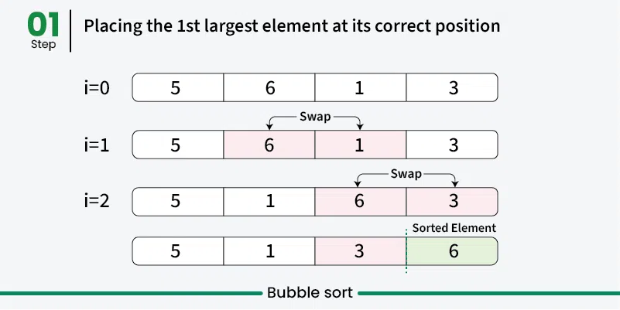
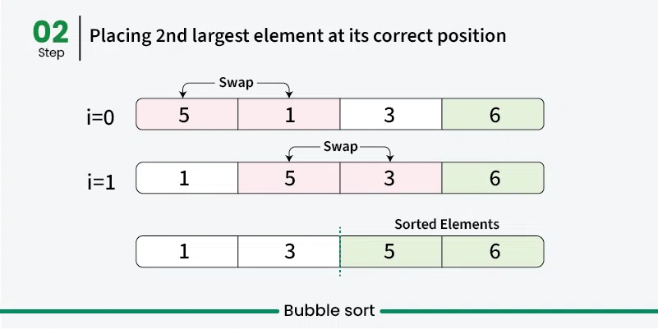
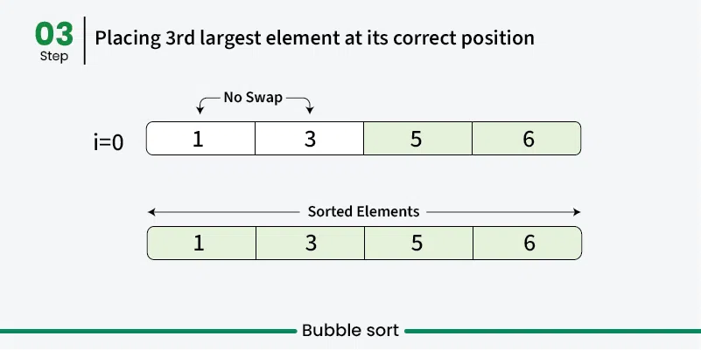
Bubble Sort Example

Slide 6
Selection Sort
Selection Sort works by repeatedly selecting the smallest element from the unsorted portion and swapping it with the first unsorted element. This process continues until the entire array is sorted.
First we find the smallest element and swap it with the first element. This way we get the smallest element at its correct position.
Then we find the smallest among remaining elements (or second smallest) and move it to its correct position by swapping.
Keep going until all elements are sorted.
4
7
2
10
1
8
unsorted
1
7
2
10
4
8
sorted
unsorted
1
2
7
10
4
8
sorted
unsorted
1
2
4
10
7
8
Selection Sort: Basic Algorithm
For each position i from 0 to length-2
Find smallest element in positions i to length-1
Swap it with element in position i
1
2
4
7
10
8
1
2
4
7
8
10
which next?
sorted
i
unsorted
Notes:
The idea is to find the smallest value in the remaining unsorted array and put that at the start. And then just keep repeating that process over and over.

Slide 7
Selection Sort Time Complexity
Time complexity: O(n²), as there are two nested loops:
Outer loop to select each element one by one with O(n) complexity
Inner loop to compare that element with every other element with O(n) complexity
Selection Sort | GeeksforGeeks
https://www.geeksforgeeks.org/selection-sort-algorithm-2/
https://www.geeksforgeeks.org/time-and-space-complexity-analysis-of-selection-sort/
https://www.youtube.com/watch?v=xWBP4lzkoyM
Selection Sort: Basic Algorithm
For each position i from 0 to length-2
Find smallest element in positions i to length-1
Swap it with element in position i
which next?
sorted
i
unsorted

Slide 8
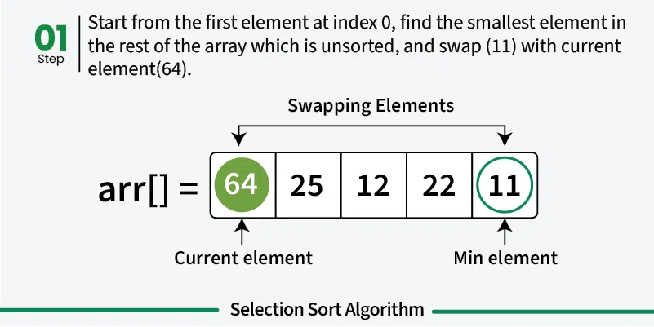
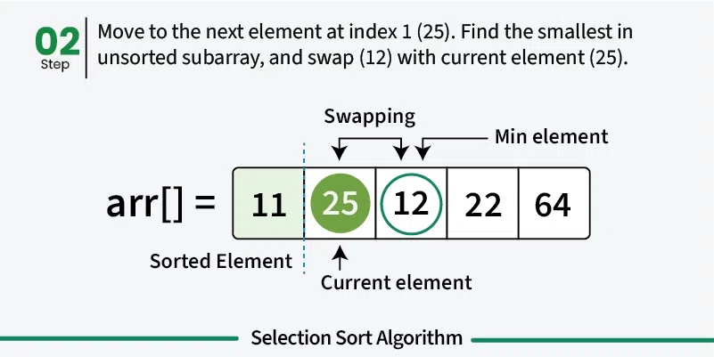
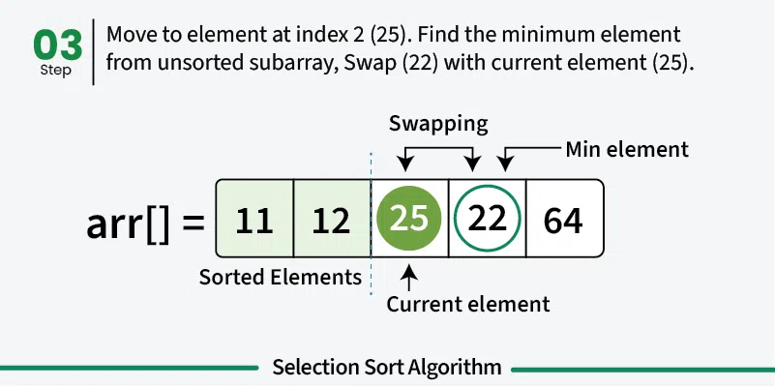
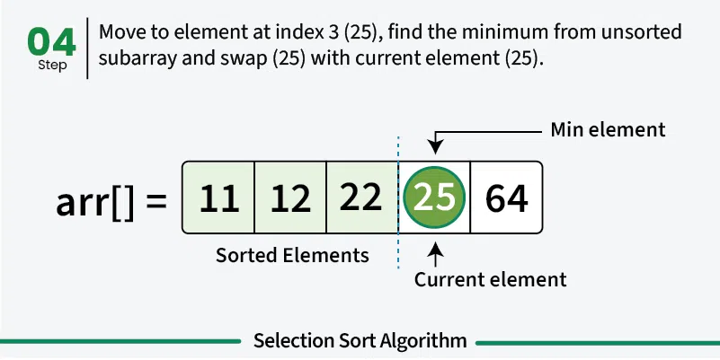
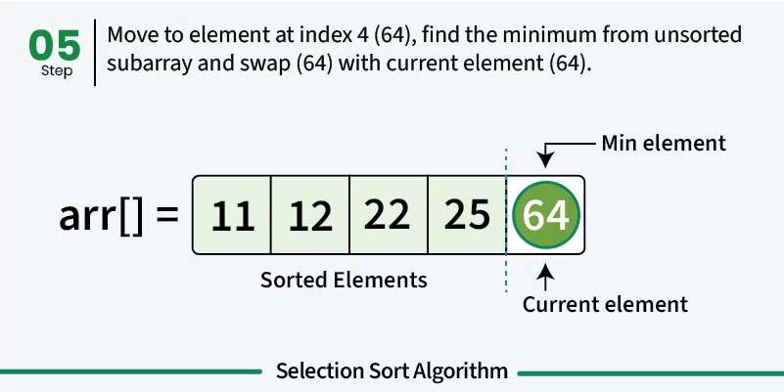
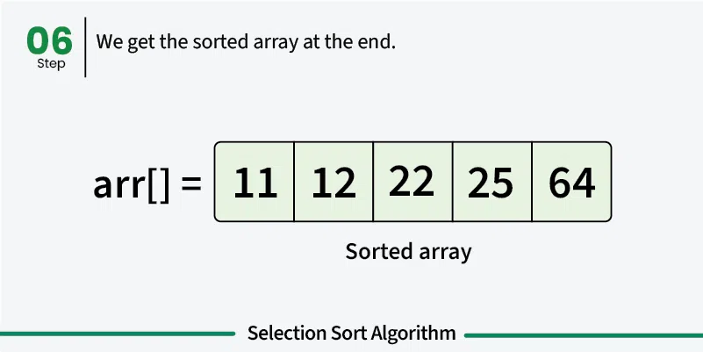

Slide 9
Insertion Sort
Insertion sort works by iteratively inserting each element of an unsorted list into its correct position in a sorted portion of the list. It is like sorting playing cards in your hands. You split the cards into two groups: the sorted cards and the unsorted cards. Then, you pick a card from the unsorted group and put it in the right place in the sorted group.
We start with second element of the array as first element in the array is assumed to be sorted.
Compare second element with the first element and check if the second element is smaller then swap them.
Move to the third element and compare it with the first two elements and put at its correct position
Repeat until the entire array is sorted.
Insertion Sort: Basic Algorithm
For each position i from 1 to length-1
Swap successive pairs to put value in position i in correct location relative to earlier values
1
8
4
3
7
2
pos 1
1
4
8
3
7
2
pos 2
sorted
i
unsorted
1
3
4
8
7
2
pos 3
1
3
4
7
8
2
pos 4
1
2
3
4
7
8
pos 4

Slide 10
Insertion Sort Time Complexity
Time complexity: O(n²), as there are two nested loops:
Outer loop to select each element in the unsorted group one by one, with O(n) complexity
Inner loop to insert that element into the sorted group, with O(n) complexity
Insertion Sort | GeeksforGeeks
https://www.geeksforgeeks.org/insertion-sort-algorithm/
https://www.geeksforgeeks.org/time-and-space-complexity-of-insertion-sort-algorithm/
https://www.youtube.com/watch?v=OGzPmgsI-pQ
Insertion Sort: Basic Algorithm
For each position i from 1 to length-1
Swap successive pairs to put value in position i in correct location relative to earlier values
1
8
4
3
7
2
pos 1
1
4
8
3
7
2
pos 2
sorted
i
unsorted
1
3
4
8
7
2
pos 3
1
3
4
7
8
2
pos 4
1
2
3
4
7
8
pos 4

Slide 11
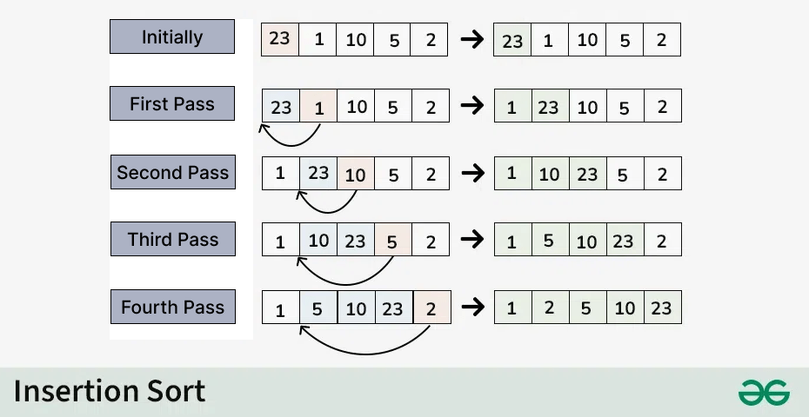
Insertion Sort Example 1

Slide 12
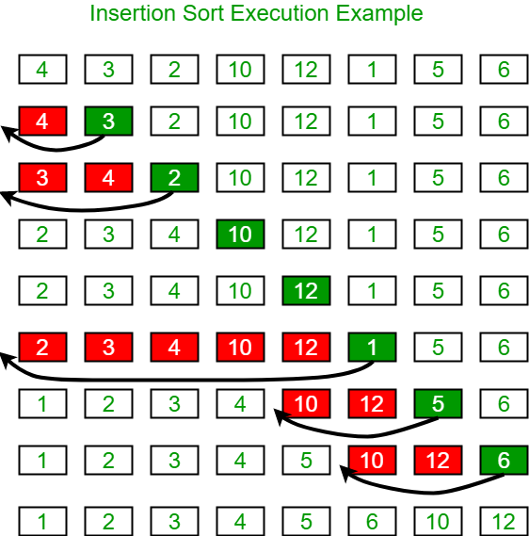
Insertion Sort Example 2

Slide 13
Heap Sort: Binary Heap
In a heap the largest (or smallest) element is always stored at the root, hence the name "heap". A heap is useful data structure when you need to remove the largest (or smallest) element. A common use of a heap is to implement a priority queue and Heap Sort.
A binary heap is a complete binary tree which is an efficient data structure satisfies the heap ordering property.
In a complete tree, every level (except possibly the leaf level) is completely filled; the leaf level is filled from left to right.
Level 0
Level 1
Level 2
Level 3
Level 4 (leaf)
A complete binary tree with n = 16 nodes (height = 4)
Not a complete binary tree (not filled from left to right)

Slide 14
Complete Binary Tree or Not?
Above: complete binary trees
Below: not complete binary trees
Leaf level is not filled from left to right.
Non-leaf level is not completely filled.

Slide 15
Heap Sort: Binary Heap
The heap ordering can be one of two types:
The min-heap property: the value of each node is greater than or equal to the value of its parent, with the minimum-value element at the root.
The max-heap property: the value of each node is less than or equal to the value of its parent, with the maximum-value element at the root.
A heap is not a sorted structure and can be regarded as partially ordered. There is no particular relationship among nodes on any given level, even among the siblings.
Since a heap is a complete binary tree, it has a smallest possible height - a heap with n nodes has O(log n) height.
in this lecture
1
9
4
2
8
5
7
9
8
6
2
1
Max Heap Animations | Data Structure | Visual How
https://www.youtube.com/watch?v=uU0iWaVxMgc

Slide 16


Binary Heap: Array Representation
Array representation.
Indices range in [1, n].
Take nodes in level order.
No explicit pointers needed!
Only works for complete binary trees
i 0 1 2 3 4 5 6 7 a[i] - T S R P N O A
8 9 10 11
E I H G
T
S R
P N O A
1
T
2
S
3
R
E I H G
4 P
5
N
6
O
7
A
8
E
9
I
10
11
H G
A Min Heap
Proposition. Can use array indices to move through tree.
Parent of node at index k is at floor(k/2).
Parent of node at 8 or 9 is at floor(8/2)= floor(9/2)=4.
Children of node at index k are at 2k and 2k+1.
Children of node at 4 is at 2*4=8 and 2*4+1=9
Proposition. Largest key is a[1], which is root of binary tree.
Leaf nodes have indices [floor(n/2)+1, n]
[floor(11/2)+1, n]=[6, 11]
Non-leaf nodes have indices [1, floor(n/2)]
[1, floor(11/2)]=[1, 5]
Can we represent a tree with an array? - Inside code
https://www.youtube.com/watch?v=EitnYxinKkw
Notes:
https://www.youtube.com/watch?v=EitnYxinKkw

Slide 17
Binary Heap Operations: Promotion
Scenario. A key becomes larger than its parent’s key.
To eliminate the violation:
Exchange key in child with key in parent.
Repeat until heap order restored.
S
P
R
N
5
T
O
A
violates heap order (larger key than parent)
private void swim(int k)
{
while (k > 1 && less(k/2, k))
{
exch(k, k/2); k = k/2;
E
I
H
G
1
T
2
S
R
}
parent of node at k is at k/2
N
5
P
O
A
}
E
I
H
G

Slide 18

Binary Heap Operations: Insert
Insert. Add node as leaf, then swim it up.
Cost. O(log n) compares since tree height is O(log n).
insert
T
T
P
R
P
R
N
H
O A
key to insert
N
H
O
A
add key to heap violates heap order
E
I
G
S
E
I
G
S
T
S R
P O
G H
public void insert(Key x)
{
pq[++n] = x; swim(n);
}
swim up
N
A
E
I

Slide 19

Binary Heap Operations: Demotion
Scenario. A key becomes smaller than one (or both) of its children’s.
To eliminate the violation:
Exchange key in parent with key in larger of the two children.
Repeat until heap order restored.
(Called max_heapify in video)
violates heap order (smaller than a child)
T
private void sink(int k, int n)
{
2 _{H}
R
P
5
S
O
A
while (2*k <= n)
{
int j = 2*k;
children of node at k
are 2*k and 2*k+1
E
I
N
G
if (j < n && less(j, j+1)) j++; if (!less(k, j)) break;
exch(k, j); k = j;
T
2
S
R
P
5
N
O
A
E
I
10
H
G
}
}
Top-down max_heapify (sink)

Slide 20

Binary Heap Operations: DeleteMax
Delete max. Exchange root with rightmost leaf node (last element of the array), then sink it down.
Cost. O(log n) compares.
remove the maximum
T
key to remove
H
violates heap order
R
O A
S
R
S
N
P
O A
exchange key with root
N
P
E
I
G
H
E
I
G
T
remove node from heap
public Key delMax()
{
Key max = pq[1]; exch(1, n--); sink(1);
pq[n+1] = null;
S
sink down
P
R
N
H
O
A
E
I
G
return max;
}

Slide 21
Heap Sort Algorithm
Basic plan for in-place sort.
View input array as a complete binary tree.
Heap construction: build a max-heap with all n keys.
Sortdown: repeatedly remove the maximum key.
keys in arbitrary order
build max heap (in place)
sorted result (in place)
1
S
X
1 _{A}
2
3
2 _{E}
3 _{E}
6 _{O} 7 _{P}
O
R
7
T
S
4
5
6
4 _{L}
M
11
T E
8 9 10 _{L} 11 _{E}
X A
P
L
R A
5
M P
M
O E E
8
9
10
R
S T X
1 2 3 4 5 6 7 8 9 10 11
1 2 3 4 5 6 7 8 9 10 11
1 2 3 4 5 6 7 8 9 10 11
S | O | R | T | E | X | A | M | P | L | E
X | T | S | P | L | R | A | M | O | E | E
A | E | E | L | M | O | P | R | S | T | X
Notes:
Heaps and Heap Sort NG
https://www.youtube.com/watch?v=H5kAcmGOn4Q

Slide 22
Heap Sort: Heap Construction
for (int k = floor(n/2); k >= 1; k--) //call sink(k) on all non-leaf nodes k from bottom up
sink(k, n);
First pass. Build heap using bottom-up method.
1
S
sink(3, 11)
S
2
O
3
R
7
O
X
4
T
9 10
5
E
11
6
X
A
L
T
R A
8
M P L E
M
P E E
3-node heap
starting point (arbitrary order)
1-node heap
sink(5, 11)
S
7-node heap
sink(2, 11)
S
O
R
T
X
T
L
X A
P
L
R A
M P E E
M O E
E
3-node heap
11-node heap
sink(4, 11)
S
sink(1, 11)
X
O
R
T
S
T
L
X A
P
L
R A
3-node heap
M
P E E
M O E E
result (heap-ordered)

Slide 23































Heap Sort: Sortdown
Second pass.
Remove the maximum, one at a time.
Leave in array, instead of nulling out.
while (n > 1)
{
exch(a, 1, n--);
sink(a, 1, n);
}
X
exch(1, 9)
sink(1, 8)
R
exch(1, 6)
sink(1, 5)
T
S
P
E
M
exch(1, 3)
sink(1, 2)
E
P
L
R
A
O
L
E A
L
E
A
E
M O E E
starting point (heap-ordered)
M S T
X
A
E
O P
L
M
O P
R S T X
R S T
X
exch(1, 11)
sink(1, 10)
T
exch(1, 8)
sink(1, 7)
P
exch(1, 5)
sink(1, 4)
L
exch(1, 2)
sink(1, 1)
A
P
S
O
E
E
E
E
E
O
L
R
A
M
L
E A
A
M
O
P
L
M
O P
M E E X
R S T X
R S T X
R S T X
exch(1, 10)
sink(1, 9)
S
exch(1, 7)
sink(1, 6)
exch(1, 4)
sink(1, 3)
E
1 _{A}
P
R
O
A
E
2 _{E}
3 _{E}
L
E A
M
E
M
4 _{L} 5 _{M}
6 _{O} 7 _{P}
O
A
L
E P
L
O P
8 _{R} 9 _{S} 10 _{T} 11 _{X}
result (sorted)
M E T X
R
S T X
R S T X

Slide 24
Heap Sort: Java Implementation
public class Heap
{
public static void sort(Comparable[] a)
{
int n = a.length;
for (int k = n/2; k >= 1; k--)
Integer arithmetic k=n/2
takes the floor of n/2
sink(a, while (n > { | k, 1) | n);
exch(a, | 1, | n);
sink(a, | 1, | --n);
O(nlogn)
}
}
private static void sink(Comparable[] a, int k, int n)
{ /* as before */ }
but make static (and pass arguments)
private static boolean less(Comparable[] a, int i, int j)
{ /* as before */ }
private static void exch(Object[] a, int i, int j)
{ /* as before */ }
but convert from 1-based indexing to 0-base indexing
}

Slide 25
Heap Sort: Trace
1
S
2
O
3
R
7
4
T
9 10
5
E
11
6
X
A
sink(k, N)
8
M P L E
a[i]
starting point (arbitrary order)
N | k | 0 | 1 | 2 | 3 | 4 | 5 | 6 | 7 | 8 | 9 | 10 | 11
initial | values |  | S | O | R | T | E | X | A | M | P | L | E
11 | 5 |  | S | O | R | T | L | X | A | M | P | E | E
11 | 4 |  | S | O | R | T | L | X | A | M | P | E | E
11 | 3 |  | S | O | X | T | L | R | A | M | P | E | E
11 | 2 |  | S | T | X | P | L | R | A | M | O | E | E
11 | 1 |  | X | T | S | P | L | R | A | M | O | E | E
heap-ordered X T S P L R A M O E E
10 | 1 | T |  | P | S | O | L | R | A | M | E | E | X
9 | 1 | S |  | P | R | O | L | E | A | M | E | T | X
8 | 1 | R |  | P | E | O | L | E | A | M | S | T | X
7 | 1 | P |  | O | E | M | L | E | A | R | S | T | X
6 | 1 | O |  | M | E | A | L | E | P | R | S | T | X
5 | 1 | M |  | L | E | A | E | O | P | R | S | T | X
4 | 1 | L |  | E | E | A | M | O | P | R | S | T | X
3 | 1 | E |  | A | E | L | M | O | P | R | S | T | X
2 | 1 | E |  | A | E | L | M | O | P | R | S | T | X
1 | 1 | A |  | E | E | L | M | O | P | R | S | T | X
sorted | result | A |  | E | E | L | M | O | P | R | S | T | X
3-node heap
7-node heap
11-node heap
red: exchanged
black: compared
Heap Sort trace (array contents just after each sink)

Slide 26
Binary Heap: Practical improvements
Multiway heaps. Complete d-way tree.
Parent’s key no smaller than its children’s keys.
Fact. Height of complete d-way tree on n nodes is O(log _{d} n).
Z
Y
T
G
J
X
P
W
I
K
A
B
D
E
H
F
R
S
V
C
L M
Q N O
3-way heap

Slide 27
Binary Heap vs. Binary Search Tree
Binary Heap is different from Binary Search Tree (BST, e.g., red-black tree)
Binary Heap: the max-heap property
Value of each node is less than or equal to the value of its parent, with the maximum-value element at the root.
A heap is not a sorted structure and can be regarded as partially ordered.
BST: Ordered, or sorted, binary trees
Items to the left of a given node are smaller.
Items to the right of a given node are larger.
Both structures offer O(log n) time complexity for certain operations, they are used in different scenarios.
Heap Sort is used for efficient sorting and simple priority queue implementations
BST can also be used for sorting, by insertions followed by in-order traversal, with O(n log(n)) average-case complexity.
Red-black trees are for maintaining ordered data with frequent updates and searches.
9
8
5
6
2
1
Binary Heap
8
5
10
1
7
9
Binary Search Tree
In-order traversal gives sorted list [1,5,7,8,9,10]
Notes:
Each node can have 2 subtrees.
, but is less efficient in terms of memory and execution time than efficient sorting algorithms.

Slide 28
Quick Sort
Quick Sort is based on the principle of divide and conquer: breaking down the problem into smaller sub-problems.
Choose a Pivot: Select an element from the array as the pivot. The choice of pivot can vary (e.g., first element, last element, random element, or median).
Partition the Array:
1. The pivot is compared with each element in the array.
2. Elements smaller than the pivot are moved to its left.
3. Elements larger than the pivot are moved to its right.
4. The pivot is placed in its final sorted position.
Recursively Call: Recursively apply the same process to the two partitioned sub-arrays (left and right of the pivot).
Base Case: The recursion stops when there is only one element left in the sub-array, as a single element is already sorted.
Quick Sort | geeksforgeeks
https://www.geeksforgeeks.org/quick-sort-algorithm/
QUICK SORT | Sorting Algorithms | DSA | GeeksforGeeks
https://www.youtube.com/watch?v=PgBzjlCcFvc&t=80s
Partition Function of Quick Sort | GeeksforGeeks https://www.youtube.com/watch?v=OwR53k9DZ9c
Notes:
Rearrange the array around the pivot. After partitioning, all elements smaller than the pivot will be on its left, and all elements greater than the pivot will be on its right. The pivot is then in its correct position, and we obtain the index of the pivot.

Slide 29
Quick Sort: Selection of Pivot
The pivot is an element chosen from the array that serves as a reference point for partitioning the array into two subarrays. There are several strategies for selecting the pivot:
###First or Last Element as Pivot. Simple to implement but can lead to poor performance if the array is already sorted or nearly sorted.
### Random Element as Pivot. This can help avoid worst-case scenarios and provide more consistent performance across different input distributions.
### Median-of-Three. This method selects the median of the first, middle, and last elements of the array as the pivot. It provides a good balance between simplicity and performance.
Notes:
We use the first element as Pivot in the examples.
## Recursive Implementation
After partitioning, the Quick Sort algorithm recursively applies the same process to the subarrays on either side of the pivot until the entire array is sorted[1][3].
## Code Example (Python)
Here's a basic implementation of Quick Sort using the last element as the pivot:
```python
def partition(array, low, high):
pivot = array[high]
i = low - 1
for j in range(low, high):
if array[j] <= pivot:
i += 1
array[i], array[j] = array[j], array[i]
array[i + 1], array[high] = array[high], array[i + 1]
return i + 1
def Quick Sort(array, low, high):
if low < high:
pi = partition(array, low, high)
Quick Sort(array, low, pi - 1)
Quick Sort(array, pi + 1, high)
# Example usage
data = [8, 7, 2, 1, 0, 9, 6]
size = len(data)
Quick Sort(data, 0, size - 1)
print('Sorted Array:', data)
```
## Performance Considerations
The choice of pivot can significantly affect the algorithm's performance:
- **Best-case scenario**: The pivot consistently divides the array into roughly equal halves, resulting in O(n log n) time complexity.
- **Worst-case scenario**: Poor pivot selection (e.g., always choosing the smallest or largest element) can lead to O(n^2) time complexity.
## Advanced Pivot Strategies
Research has explored more sophisticated pivot selection methods to improve Quick Sort's performance:
- **Multi-pivot Quick Sort**: This variant uses multiple pivots to partition the array, potentially reducing the number of comparisons and improving cache efficiency[2].
- **Median of medians**: This algorithm guarantees a good pivot selection, ensuring O(n log n) worst-case time complexity, but is rarely used in practice due to its overhead[4].
By carefully choosing the pivot and implementing optimizations, Quick Sort remains one of the most efficient and widely used sorting algorithms in practice.
Citations:
[1] https://www.geeksforgeeks.org/quick-sort-algorithm/
[2] https://cs.stanford.edu/~rishig/courses/ref/l11a.pdf
[3] https://www.programiz.com/dsa/quick-sort
[4] https://en.wikipedia.org/wiki/Quick Sort
[5] https://builtin.com/articles/Quick Sort
[6] https://stackoverflow.com/questions/164163/Quick Sort-choosing-the-pivot
[7] https://www.youtube.com/watch?v=Vtckgz38QHs
[8] https://algs4.cs.princeton.edu/23Quick Sort/

Slide 30
Quick Sort Time Complexity
Worst case. Number of compares is quadratic.
・ n + (n - 1) + (n - 2) + … + 1 →O(n ²).
・More likely that your computer is struck by lightning bolt.
Average case. Number of compares is ~1.39 n log n.
・39% more compares than Merge Sort.
・But faster than Merge Sort in practice because of less data movement.
Random shuffle.
・Probabilistic guarantee against worst case.
・Basis for math model that can be validated with experiments.

Slide 31
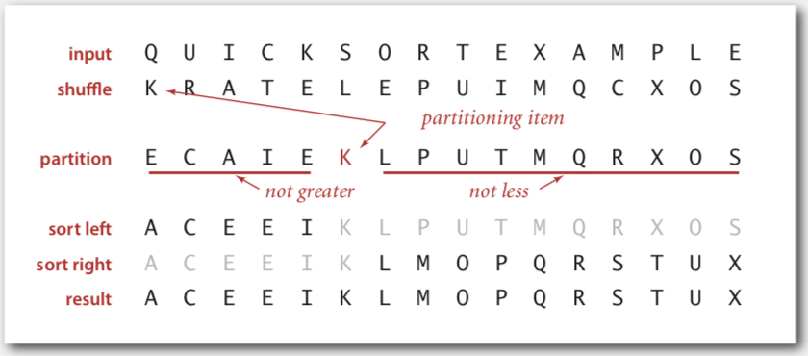
Quick Sort Example 1
Shuffle the array.
Partition so that, for some pivot j
entry a[j] is in place
no larger entry to the left of j
no smaller entry to the right of j
Sort each piece recursively.
Choose the first element as pivot
Notes:
Quick Sort Animations | Data Structure | Visual How
https://www.youtube.com/watch?v=4vc5OYLMcYE

Slide 32
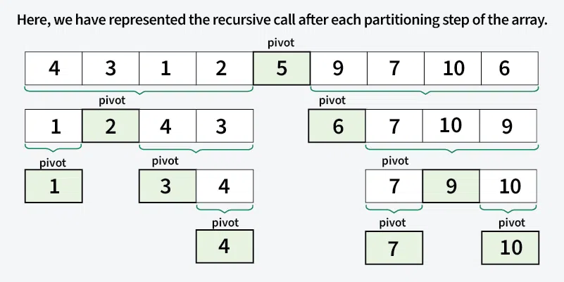
Quick Sort Example 2
Input array [4, 3, 9, 7, 1, 2, 10, 6, 5]
Choose the last element as pivot
Notes:
https://www.geeksforgeeks.org/time-and-space-complexity-of-radix-sort-algorithm/

Slide 33
Partition Operation
Repeat until i and j pointers cross.
Scan i from left to right so long as (a[i] < a[lo]).
Scan j from right to left so long as (a[j] > a[lo]).
Exchange a[i] with a[j].
When pointers cross.
Exchange a[lo] with a[j].
K
R
A
T
E
L
E
P
U
I
M
Q
C
X
O
S
K
R
A
T
E
L
E
P
U
I
M
Q
C
X
O
S
pivot
lo
i
j
j
j
j
K
C
A
T
E
L
E
P
U
I
M
Q
R
X
O
S
lo
i
i
i
j
j
j
j
K
C
A
I
E
L
E
P
U
T
M
Q
R
X
O
S
lo
i
i
i
j
j
j
j
K
C
A
I
E
E
L
P
U
T
M
Q
R
X
O
S
lo
j
i
j
i
E
C
A
I
E
K
L
P
U
T
M
Q
R
X
O
S
lo
j
i
hi

Slide 34

Quick Sort: Trace
initial values random shuffle
lo j hi 0 1 2 3 4 5 6 7 8 9 10 11 12 13 14 15
 |  |  | Q | U | I | C | K | S | O | R | T | E | X | A | M | P | L | E
 |  |  | K | R | A | T | E | L | E | P | U | I | M | Q | C | X | O | S
0 | 5 | 15 | E | C | A | I | E | K | L | P | U | T | M | Q | R | X | O | S
0 | 3 | 4 | E | C | A | E | I | K | L | P | U | T | M | Q | R | X | O | S
0 | 2 | 2 | A | C | E | E | I | K | L | P | U | T | M | Q | R | X | O | S
0 | 0 | 1 | A | C | E | E | I | K | L | P | U | T | M | Q | R | X | O | S
1 |  | 1 | A | C | E | E | I | K | L | P | U | T | M | Q | R | X | O | S
4 |  | 4 | A | C | E | E | I | K | L | P | U | T | M | Q | R | X | O | S
6 | 6 | 15 | A | C | E | E | I | K | L | P | U | T | M | Q | R | X | O | S
7 | 9 | 15 | A | C | E | E | I | K | L | M | O | P | T | Q | R | X | U | S
7 | 7 | 8 | A | C | E | E | I | K | L | M | O | P | T | Q | R | X | U | S
8 |  | 8 | A | C | E | E | I | K | L | M | O | P | T | Q | R | X | U | S
10 | 13 | 15 | A | C | E | E | I | K | L | M | O | P | S | Q | R | T | U | X
10 | 12 | 12 | A | C | E | E | I | K | L | M | O | P | R | Q | S | T | U | X
10 | 11 | 11 | A | C | E | E | I | K | L | M | O | P | Q | R | S | T | U | X
10 |  | 10 | A | C | E | E | I | K | L | M | O | P | Q | R | S | T | U | X
14 | 14 | 15 | A | C | E | E | I | K | L | M | O | P | Q | R | S | T | U | X
15 |  | 15 | A | C | E | E | I | K | L | M | O | P | Q | R | S | T | U | X
 |  |  | A | C | E | E | I | K | L | M | O | P | Q | R | S | T | U | X
no partition for subarrays of size 1
result
Quick Sort trace (array contents after each partition)

Slide 35







Partition Operation: Java Implementation
private static int partition(Comparable[] a, int lo, int hi)
{
int i = lo, j = hi+1; while (true)
{
while (less(a[++i], a[lo]))
if (i == hi) break;
find item on left to swap
while (less(a[lo], a[--j]))
if (j == lo) break;
find item on right to swap
if (i >= j) break; exch(a, i, j);
check if pointers cross
swap
}
exch(a, lo, j); return j;
swap with partitioning item return index of item now known to be in place
}
before v
lo
during
v | $≤$ v |  | $≥$ v
after
$≤$ v
v
$≥$ v
hi
i
j
lo
j
hi

Slide 36

Quick Sort: Java Implementation
public class Quick
{
private static int | partition(Comparable[] | a, | int | lo, | int | hi)
{/* see previous | slide / }
public static void sort(Comparable[] a)
{
StdRandom.shuffle(a); sort(a, 0, a.length - 1);
Shuffle needed to improve performance
}
private static void sort(Comparable[] a, int lo, int hi)
{
if (hi <= lo) return;
int j = partition(a, lo, hi);
sort(a, lo, j-1);
sort(a, j+1, hi);
}
}
Pivot selection

Slide 37
Quick Sort is Equivalent to Sorting by BST
Key idea: compareTo calls are same for BST insert and Quick Sort.
Every number gets compared to 5; 1, 3, 4 get compared to only 2.
Recall: Insertion into a BST has average-case complexity O(N log N).
5
2
6
1
3
9
4
7
10
Binary Search Tree
In-order traversal gives sorted list [1,2,3,4,5,6,7,9,10]

Slide 38

Quick Sort: Best-case Analysis
Best case. Number of compares is ~ N log N.
When the list is randomly shuffled:
If we happen to always pick the median element as the pivot, then Quick Sort has the best-case complexity of O(n log n). This corresponds to a balanced BST.
initial values
random shuffle

Slide 39
Quick Sort: Worst-case Analysis
Worst case. Number of compares is O(N²).
When the list is already sorted:
If we always pick the first element as the pivot (shown in the right), then Quick Sort has the worst-case complexity of O(n²). This corresponds to a very unbalanced BST.
If we always pick the middle element as the pivot, then Quick Sort has the best-case complexity of O(n log n). This corresponds to a balanced BST.
initial values
random shuffle

Slide 40

Quick Sort: Practical Improvements
Insertion sort small subarrays.
・Even Quick Sort has too much overhead for tiny subarrays.
・Cutoff to insertion sort for ≈ 10 items.
・Note: could delay insertion sort until one pass at end.
private static void sort(Comparable[] a, int lo, int hi)
{
if (hi <= lo + CUTOFF - 1)
{
Insertion.sort(a, lo, hi); return;
}
int j = partition(a, lo, hi);
sort(a, lo, j-1);
sort(a, j+1, hi);
}

Slide 41

Merge Sort
Merge Sort is based on the principle of divide and conquer: breaking down the problem into smaller sub-problems.
Divide array into two halves.
Recursively sort each half.
Merge two halves.
input | M | E | R | G | E | S | O | R | T | E | X | A | M | P | L | E
sort left half | E | E | G | M | O | R | R | S | T | E | X | A | M | P | L | E
sort right half | E | E | G | M | O | R | R | S | A | E | E | L | M | P | T | X
merge results | A | E | E | E | E | G | L | M | M | O | P | R | R | S | T | X
Merge Sort overview

Slide 42
Merge Sort Time Complexity
Merge Sort: Basic Algorithm
If list has one element, return.
Divide list in half
Sort first half Sort second half
Merge sorted lists
5
3
2
4
1
5
3
2
4
1
5
3
2
4
1
Keep dividing by two until lists have size 1
log₂(n)
3
5
2
4
1
3
5
2
1
4
Each time we divide, we call Merge Sort on two (smaller) lists
3
5
1
2
4
*Asymptotics is not the only measure of performance
HOW?
Divide and conquer. Recursion!
1
2
3
4
5
O(n) work to merge all the lists on one level
compare the head of each list
Complexity?
O(nlog(n))

Slide 43
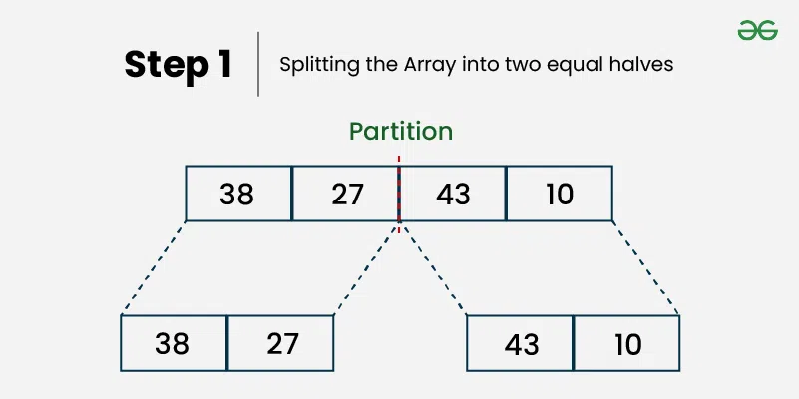
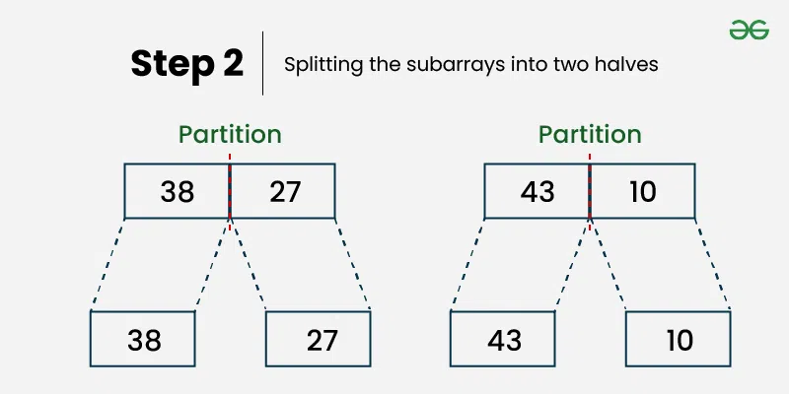
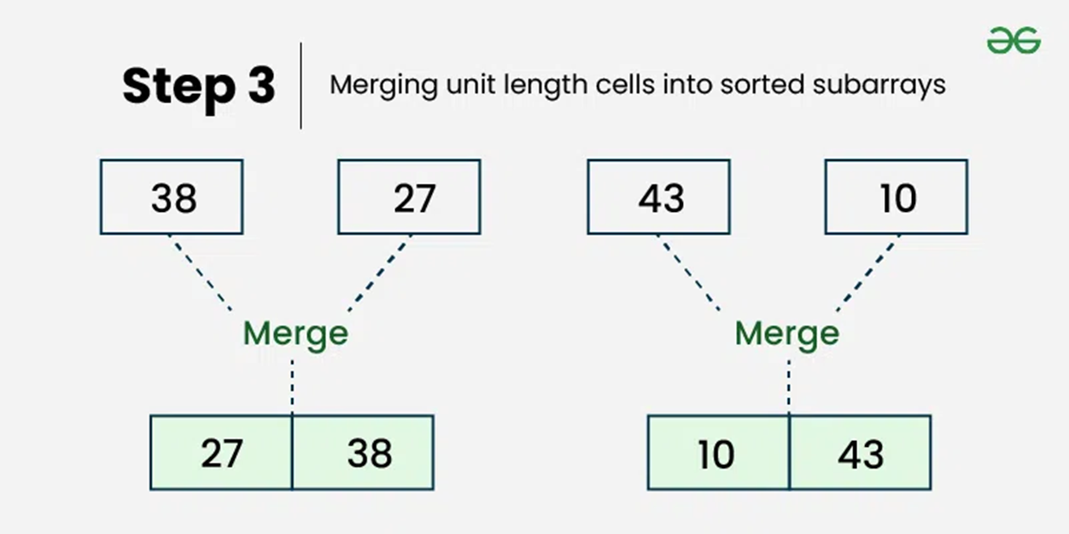
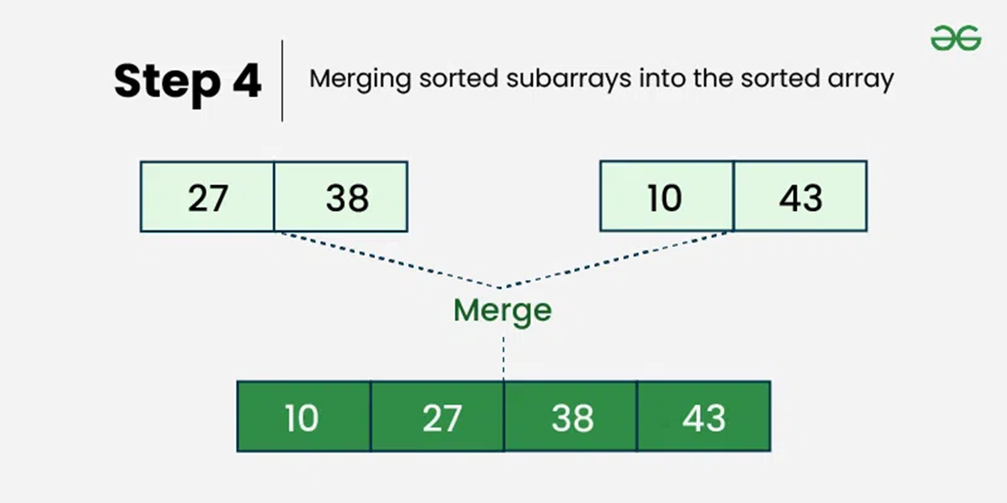
Merge Sort Example 1

Slide 44
Merge Operation
Goal. Given two sorted subarrays a[lo] to a[mid] and a[mid+1] to a[hi], obtain sorted array a[lo] to a[hi], by selecting the smaller of the smallest elements in each subarray and put it into the sorted array a[].
lo
mid
mid+1
hi
a[]
E
E
G
M
R
A
C
E
R
T
sorted
sorted
k
k
k
k
k
k
k
k
k
k
a[]
A
C
E
E
E
G
M
R
R
T
sorted
i
i
i
i
i
j
j
j
j
j
aux[]
E
E
G
M
R
A
C
E
R
T
one subarray exhausted, take from other
Merge Sort Algorithm: A Step-by-Step Visualization
https://www.youtube.com/watch?v=ho05egqcPl4

Slide 45

Merge Operation: Java Implementation
private static void merge(Comparable[] a, Comparable[] aux, int lo, int mid, int hi)
{
assert isSorted(a, | lo, mid); | // | precondition: | a[lo..mid] | sorted
assert isSorted(a, | mid+1, hi); | // | precondition: | a[mid+1..hi] | sorted
for (int k = lo; k <= hi; k++) aux[k] = a[k];
copy
int i = lo, j = mid+1;
for (int k = lo; k <= hi; k++)
{
merge
if (i > mid) a[k] = aux[j++];
else if (j > hi) a[k] = aux[i++]; else if (less(aux[j], aux[i])) a[k] = aux[j++]; else a[k] = aux[i++];
}
assert isSorted(a, lo, hi);
// postcondition: a[lo..hi] sorted
}
lo
i mid
j
hi
aux[]
A | G | L | O | R | H | I | M | S | T
k
a[]
A | G | H | I | L | M

Slide 46

Merge Sort: Java implementation
public class Merge
{
private static void merge(...)
{ /* as before */ }
private static void sort(Comparable[] a, Comparable[] aux, int lo, int hi)
{
if (hi <= lo) return;
int mid = lo + (hi - lo) / 2; sort(a, aux, lo, mid); sort(a, aux, mid+1, hi); merge(a, aux, lo, mid, hi);
}
public static void sort(Comparable[] a)
{
aux = new Comparable[a.length]; sort(a, aux, 0, a.length - 1);
}
}
lo
mid
hi
10 11 12 13 14 15 16 17 18 19

Slide 47
Merge Sort: Example 2 Trace
a[]
0 1 2 3 4 5 6 7 8 9 10 11 12 13 14 15
Recursive
call stack
lo
hi
M | E | R | G | E | S | O | R | T | E | X | A | M | P | L | E
merge(a, aux, 0, 0, 1) E | M | R | G | E | S | O | R | T | E | X | A | M | P | L | E
merge(a, aux, 2, 2, 3) E | M | G | R | E | S | O | R | T | E | X | A | M | P | L | E
merge(a, aux, 0, 1, 3) E | G | M | R | E | S | O | R | T | E | X | A | M | P | L | E
merge(a, aux, 4, 4, 5) E | G | M | R | E | S | O | R | T | E | X | A | M | P | L | E
merge(a, aux, 6, 6, 7) E | G | M | R | E | S | O | R | T | E | X | A | M | P | L | E
merge(a, aux, 4, 5, 7) E | G | M | R | E | O | R | S | T | E | X | A | M | P | L | E
merge(a, aux, 0, 3, 7) E | E | G | M | O | R | R | S | T | E | X | A | M | P | L | E
merge(a, aux, 8, 8, 9) E | E | G | M | O | R | R | S | E | T | X | A | M | P | L | E
merge(a, aux, 10, 10, 11) E | E | G | M | O | R | R | S | E | T | A | X | M | P | L | E
merge(a, aux, 8, 9, 11) E | E | G | M | O | R | R | S | A | E | T | X | M | P | L | E
merge(a, aux, 12, 12, 13) E | E | G | M | O | R | R | S | A | E | T | X | M | P | L | E
merge(a, aux, 14, 14, 15) E | E | G | M | O | R | R | S | A | E | T | X | M | P | E | L
merge(a, aux, 12, 13, 15) E | E | G | M | O | R | R | S | A | E | T | X | E | L | M | P
merge(a, aux, 8, 11, 15) E | E | G | M | O | R | R | S | A | E | E | L | M | P | T | X
merge(a, aux, 0, 7, 15) A | E | E | E | E | G | L | M | M | O | P | R | R | S | T | X
result after recursive call

Slide 48

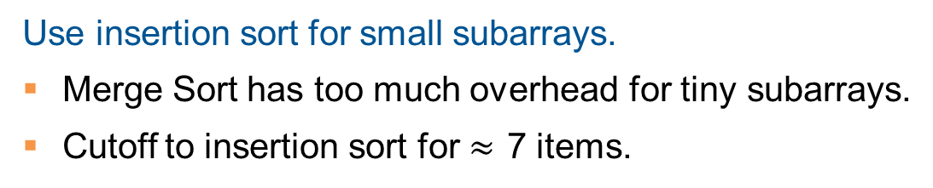
Merge Sort: Practical Improvements
Use insertion sort for small subarrays.
Merge Sort has too much overhead for tiny subarrays.
Cutoff to insertion sort for $≈$ 7 items.
private static void sort(Comparable[] a, Comparable[] aux, int lo, int hi)
{
if (hi <= lo + CUTOFF - 1)
{
Insertion.sort(a, lo, hi); return;
}
int mid = lo + (hi - lo) / 2; sort (a, aux, lo, mid);
sort (a, aux, mid+1, hi); merge(a, aux, lo, mid, hi);
}

Slide 49


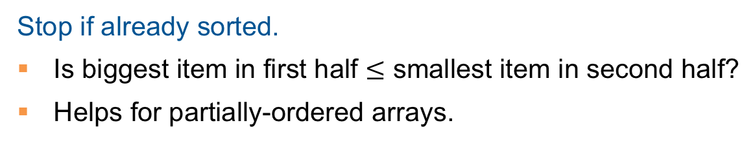
Merge Sort: Practical Improvements
Stop if already sorted.
Is biggest item in first half $≤$ smallest item in second half?
Helps for partially-ordered arrays.
A B C D E F G H I J
M N O P Q R S T U V
A B C D E F G H I J M N O P Q R S T U V
private static void sort(Comparable[] a, Comparable[] aux, int lo, int hi)
{
if (hi <= lo) return;
int mid = lo + (hi - lo) / 2; sort (a, aux, lo, mid);
sort (a, aux, mid+1, hi);
if (!less(a[mid+1], a[mid])) return; merge(a, aux, lo, mid, hi);
}

Slide 50
Stable Sorting Algorithm
A stable sorting algorithm is one that maintains the relative order of elements with equal keys in the sorted output as they appeared in the input.
Stability is important when multiple sorting operations are performed on data with multiple keys. For example, if you first sort a list of students by name and then by grade, a stable sort will ensure that students with the same grade remain sorted by name. This characteristic is crucial in scenarios where secondary attributes need to be preserved after sorting by primary attributes.
Stable Sorting Algorithms include: Bubble Sort, Insertion Sort, Merge Sort, Radix Sort (next lecture)
Notes:
A sort is said to be stable if order of equivalent items is preserved.
sort(studentRecords, BY_NAME);
sort(studentRecords, BY_SECTION);
Bas
3
Lara
Fikriyya
4
Sigurd
2
Jana
3
Jouni
3
Jouni
3
Rosella
3
Lara
1
Bas
3
Nikolaj
4
Jana
3
Rosella
3
Fikriyya
4
Sigurd
2
Nikolaj
1
4
A stable sort preserves the relative order of items with equal keys.
This means that if two elements are equal, their order will be preserved after sorting.

Slide 51
Stable Sorting Example
Name | Grade
Bas | 60
Frank | 80
Jana | 60
Jouni | 60
Lara | 20
Nick | 80
Rose | 60
Sam | 40
Name | Grade
Lara | 20
Sam | 40
Bas | 60
Jana | 60
Jouni | 60
Rose | 60
Frank | 80
Nick | 80
These lines do not cross
Sort by Name
(primary attribute)
Then sort by Grade
(secondary attribute)

Slide 52
Summary
 | inplace? | stable? | complexity (worst-case) | remarks
Bubble | ✔ | ✔ | O(n²)
Selection | ✔ |  | O(n²)
Insertion | ✔ | ✔ | O(n²)
J Heap | ✔ |  | O(n log n) | O(n log n) guarantee
Quick | ✔ |  | O(n²) | Average case complexity O(n log n), probabilistic guarantee; fastest in practice
Merge |  | ✔ | O(n log n) | O(n log n) guarantee;

Slide 53
Video Tutorials
Heap Sort
Heaps // Michael Sambol
https://www.youtube.com/playlist?list=PL9xmBV_5YoZNsyqgPW-DNwUeT8F8uhWc6
Binary Min/Max Heap
https://www.youtube.com/playlist?list=PLvTjg4siRgU197GA1yFNRWUgsPZnvjuyL
Visual How (min heap, max heap)
https://www.youtube.com/@visualhow/videos
HEAP SORT | Sorting Algorithms | DSA | GeeksforGeeks
https://www.youtube.com/watch?v=MtQL_ll5KhQ
2.6.3 Heap - Heap Sort - Heapify - Priority Queues (recommended)
https://www.youtube.com/watch?v=HqPJF2L5h9U&list=PLDN4rrl48XKpZkf03iYFl-O29szjTrs_O&index=32
Notes:
What Is a Binary Heap? (Talks about min heap)
https://www.youtube.com/watch?v=AE5I0xACpZs

Slide 54
Video Tutorials
Quick Sort
Quick sort in 4 minutes (recommended)
https://www.youtube.com/watch?v=Hoixgm4-P4M
Quick Sort Algorithm: A Step-by-Step Visualization
https://www.youtube.com/watch?v=bZkzH5x0SKU
Visualization of Quick sort (HD)
https://www.youtube.com/watch?v=aXXWXz5rF64
Merge Sort
Merge sort in 3 minutes
https://www.youtube.com/watch?v=4VqmGXwpLqc
Merge Sort Algorithm: A Step-by-Step Visualization (recommended)
https://www.youtube.com/watch?v=ho05egqcPl4
Merge Sort Animations | Data Structure | Visual How
https://www.youtube.com/watch?v=spVhtO_IcGg
Notes:
Merge Sort vs Quick Sort
https://www.youtube.com/watch?v=es2T6KY45cA

Slide 55
Video Tutorials
Sort Algos // Michael Sambol Michael Sambol
https://www.youtube.com/playlist?list=PL9xmBV_5YoZOZSbGAXAPIq1BeUf4j20pl
Merge Sort, Quick Sort, Bubble Sort, Insertion Sort, Selection Sort, Heap Sort
10 Sorting Algorithms Easily Explained
https://www.youtube.com/watch?v=rbbTd-gkajw
Bubble Sort, Selection Sort, Insertion Sort, Merge Sort, Quick Sort, Heap Sort, Counting Sort, Shell Sort, Tim Sort, Radix Sort
Notes:
Insertion Sort in 2 min (Python)
https://www.youtube.com/watch?v=ZS2ruPQm9QQ
Selection Sort in 2 min (Python)
https://www.youtube.com/watch?v=O6qX5xHXWpI
Bubble Sort in 2 min (Python)’
https://www.youtube.com/watch?v=2DNItBUngrA

